Slide 1
HTML 5
Hypertext Markup Language

Slide 2
http-server

Slide 3
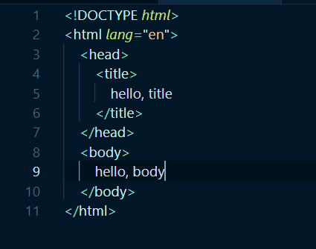
Simple Page
Notes:
The first line, <!DOCTYPE html>, is a declaration that the page follows the HTML standard.
Next is a tag, a word in brackets like <html> and </html>.
The first is a start or open tag, and the second is a close tag, which looks almost the same but with a / in front of the tag’s name.
In this case, the tags indicate the start and end of the HTML page.
The start tag here has an attribute as well, lang="en" which specifies that the language of the page will be in English, to help the browser translate the page if needed.
Notice that attributes are key-value pairs.
Nested within the <html> tag are two more tags, <head> and <body>, which are both like children nodes in a tree.
And within <head> is the <title> tag, the contents of which we see in a tab or window’s title in a browser.
Within <body> is the contents of the page itself, a text node, which we’ll see in the main view of a browser as well.

Slide 4
<!DOCTYPE html>
<html lang="en">
<head>
<title>
hello, title
</title>
</head>
<body>
hello, body
</body>
</html>

Slide 5
<!DOCTYPE html>
<html lang="en">
<head>
<title>
hello, title
</title>
</head>
<body>
hello, body
</body>
</html>

Slide 6
<!DOCTYPE html>
<html lang="en">
<head>
<title>
hello, title
</title>
</head>
<body>
hello, body
</body>
</html>

Slide 7
<!DOCTYPE html>
<html lang="en">
<head>
<title>
hello, title
</title>
</head>
<body>
hello, body
</body>
</html>

Slide 8
<!DOCTYPE html>
<html lang="en">
<head>
<title>
hello, title
</title>
</head>
<body>
hello, body
</body>
</html>

Slide 9
validator.w3.org

Slide 10
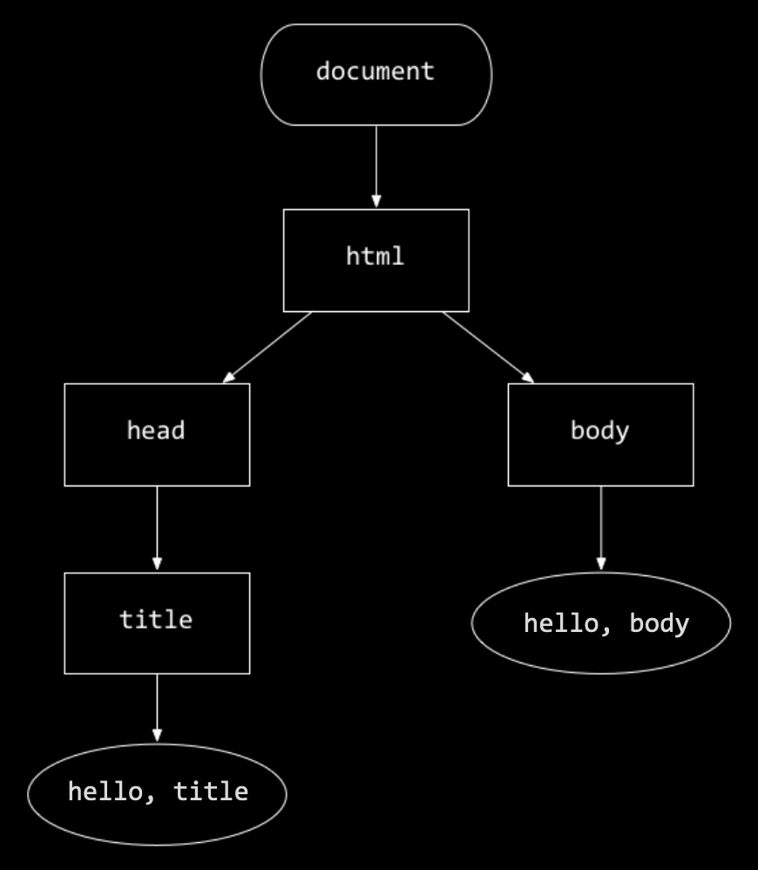
In memory representation
The page will be loaded into the browser’s memory as a data structure, like this tree:

Slide 11
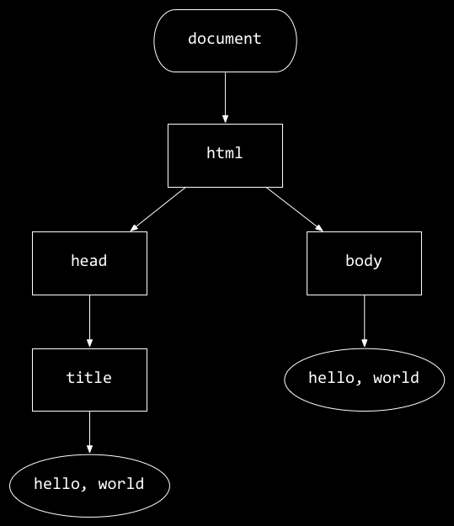
<!DOCTYPE html>
<html lang="en">
<head>
<title>
hello, title
</title>
</head>
<body>
hello, body
</body>
</html>
hello, body
hello, title

Slide 12
Paragraph

Slide 13
Div
Span

Slide 14
Headings

Slide 15
Ordered, and Unordered List

Slide 16
Table

Slide 17
Image

Slide 18


Video and Audio

Slide 19
Embedded Video iframe

Slide 20
Links

Slide 21
Responsive Page

Slide 22
URL Parameters

Slide 23
https://www.example.com/path

Slide 24
https://www.example.com/path?key=value

Slide 25
GET /search?q=cats HTTP/1.1
Host: www.google.com
...

Slide 26
Form attributes

Slide 27
Notes
01HTML5Notes.MD

Slide 28
HTML 5
Elements

Slide 29
Elements
Header
Links
Body / Controls
<head>
<script>
<css>
<a>
<img>
<body>
<form>
<input>
<button>
<checkbox>
<option>
<ul> <li>
<ol>
<table>
<th>
<tr> <td>
<div>
<span>
<br>
<p>

Slide 30
Style Attribute
Setting the style of an HTML element

Slide 31
style
<tagname style="property:value;">
The property is a CSS property. The value is a CSS value
background-color:
<body style="background-color:powderblue;">
Color: Text Color
<h1 style="color:blue;">..</h1> <p style="color:red;">...</p>
font-family: Fonts
<h1 style="font-family:verdana;">..</h1> <p style="font-family:courier;">….</p>

